Slide 1
Agile vs waterfall

Slide 2
AGILE

Slide 3
What is agile
The Agile methodology is a way to manage a project by breaking it up into several phases. It involves constant collaboration with stakeholders and continuous improvement at every stageREGARDING MODIFICATIONS AND IMPROVEMENTS IN FINAL PRODUCT

Slide 4
THREE MAIN ROLES OF AGILE
PRODUCT OWNER
SCRUM MASTER
SCRUM TEAM

Slide 5
Why is agile used
ThIS approach prioritizes quick delivery, adapting to change, and collaboration OF STAKEHOLDERS AND TEAM ON REGULAR INTERVALS. In Agile processes, there is constant feedback, allowing for team members to adjust to challenges as they arise, and stakeholders HAVE an opportunity to communicate consistently.

Slide 6
The four principles of agile
individuals and interactions over processes and tools;
working software over comprehensive documentation;
customer collaboration over contract negotiation; and.
responding to change over following a plan.

Slide 7
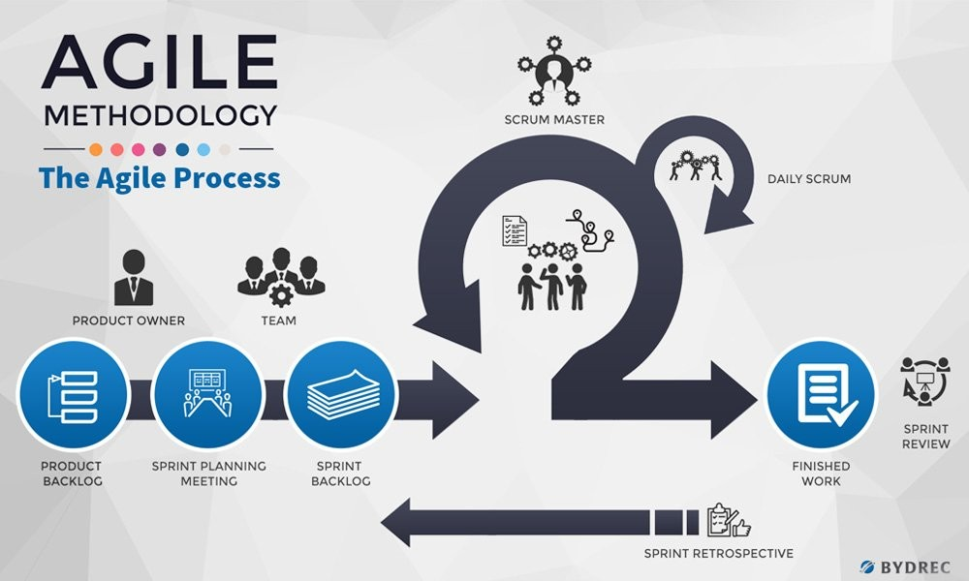

Slide 8
Pros and cons of agile
pros
cons
Product goals can be defined with stake holders
Strong and equal collaboration of team
Customer feedback is encouraged
Changes can be done adaptively
Continuously improvisation of output
Planning should be strong and maybe affected if weak
Timelines or time allotment should be clear to keep things on track

Slide 9
WATERFALL

Slide 10
WHAT IS WATERFALL METHDOLOGY
The waterfall model is a classical model used in system development life cycle to create a system with a linear and sequential PLAN. It is termed as waterfall because the model develops systematically from one phase to another in a downward WAY.

Slide 11
WHY IS WATERFALL METHODOLOGY USED?
As an internal process, the Waterfall methodology focuses very little on the end user or client involved with a project. Its main purpose has always been to help internal teams move more efficiently through the phases of a project HELPING THE TEAM TO WORK EFFICIENTLY AND PRODUCTIVILY.

Slide 12
PRINCIPLES OF WATERFALL MODEL
Waterfall model is based on three main principles:
low customer involvement
strong documentation
sequential structure

Slide 13
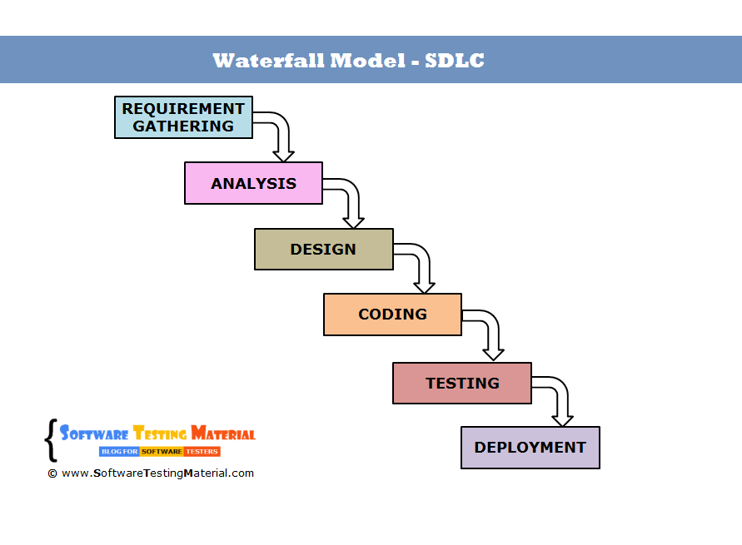
WATERFALL MODEL
THESE ARE THE PHASES IN WATERFALL MODEL,WHERE ALL THE TASKS ARE COMPLETED ONE WAY AND INCASE OF ANY MODIFICATION REQUIREMENT OR ERRORS THEN THE SEQUENCE SHOULD BE STARTED AGAIN FROM THE BEGINNING.

Slide 14
PROS AND CONS OF WATERFALL METHOD
PROS
CONS
SIMPLE METHODS AND EASY TO USE
PHASES ARE CLEAR
SUITABLE FOR SMALLER PROJECTS
EASY TO MANAGE
DOES NOT ALLOW REVISION
NOT SUITABLE FOR COMPLEX PROJECTS
IN CASE OF MODIFICATION , METHODS SHOULD START AGAIN FROM THE FIRST PHASE.
DOES NOT INCLUDE FEEDBACK PATH
HIGH RISK

Slide 15
AGILE VS WATERFALL METHOD
AGILE
WATERFALL
CONTINUOUS CYCLE OF PHASES
CUSTOMER INVOLVEMENT IS ENCOURAGED
NEW IMPROVEMENTS OR FEATURES CAN BE ENTERTAINED IN BETWEEN THE PHASES.
OUTPUT CAN BE GIVEN IN FORM OF SMALL CRUMS WITHOUT DELAYS
NEGOTIATION IS NOT ENTERTAINED
COLLABRATIVE TEAMS AND ARE SELF ORGANIZED
USING AGILE , PLANNING CAN BE PROPERLY DONE AND FINAL PRODUCT CAN BE DELIVERED ON TIME.
FLEXBILE EVOLUTION
SEQUENTIAL LINEAR PHASE
CUSTOMER INVOLVEMENT IS NOT PRESENT
PLANNING SHOULD BE DONE BEFORE STARTING THE TASK AS NO CHANGES LATER CAN BE DONE.
WHOLE OUTPUT PRODUCT IS NEEDED TO DEPLOY UNLIKE AGILE WHERE COMPLETED PHASES OF OUTPUT CAN BE DEPLOYED.
NEGOTIATION IS POSSIBLE
BEST FOR SIMPLE PROJECTS

Slide 16
THANK YOU

